Slide 1
Kudu: Fast Analytics on Fast Data
Todd Lipcon (Kudu team lead) – todd@cloudera.com
@tlipcon
Tweet (weibo?) about this talk: @getkudu or #kudu

Slide 2
Why Kudu?

Slide 3
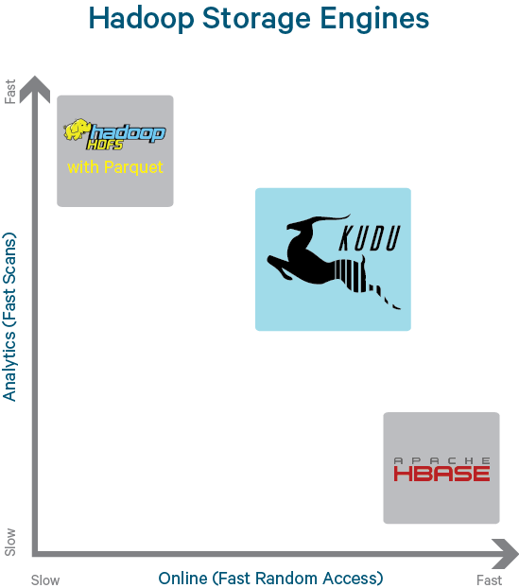
Current Storage Landscape in Hadoop Ecosystem
HDFS (GFS) excels at:
Batch ingest only (eg hourly)
Efficiently scanning large amounts of data (analytics)
HBase (BigTable) excels at:
Efficiently finding and writing individual rows
Making data mutable
Gaps exist when these properties are needed simultaneously

Slide 4
Kudu Design Goals
High throughput for big scans
Goal: Within 2x of Parquet
Low-latency for short accesses
Goal: 1ms read/write on SSD
Database-like semantics (initially single-row ACID)
Relational data model
SQL queries are easy
“NoSQL” style scan/insert/update (Java/C++ client)

Slide 5
Changing Hardware landscape
Spinning disk -> solid state storage
NAND flash: Up to 450k read 250k write iops, about 2GB/sec read and 1.5GB/sec write throughput, at a price of less than $3/GB and dropping
3D XPoint memory (1000x faster than NAND, cheaper than RAM)
RAM is cheaper and more abundant:
64->128->256GB over last few years
Takeaway: The next bottleneck is CPU, and current storage systems weren’t designed with CPU efficiency in mind.

Slide 6
What’s Kudu?

Slide 7
Scalable and fast tabular storage
Scalable
Tested up to 275 nodes (~3PB cluster)
Designed to scale to 1000s of nodes, tens of PBs
Fast
Millions of read/write operations per second across cluster
Multiple GB/second read throughput per node
Tabular
Store tables like a normal database (can support SQL, Spark, etc)
Individual record-level access to 100+ billion row tables (Java/C++/Python APIs)

Slide 8
Kudu Usage
Table has a SQL-like schema
Finite number of columns (unlike HBase/Cassandra)
Types: BOOL, INT8, INT16, INT32, INT64, FLOAT, DOUBLE, STRING, BINARY, TIMESTAMP
Some subset of columns makes up a possibly-composite primary key
Fast ALTER TABLE
Java and C++ “NoSQL” style APIs
Insert(), Update(), Delete(), Scan()
Integrations with MapReduce, Spark, and Impala
Apache Drill work-in-progress

Slide 9
Use cases and architectures

Slide 10
Kudu Use Cases
Kudu is best for use cases requiring a simultaneous combination of sequential and random reads and writes
Time Series
Examples: Stream market data; fraud detection & prevention; risk monitoring
Workload: Insert, updates, scans, lookups
Machine Data Analytics
Examples: Network threat detection
Workload: Inserts, scans, lookups
Online Reporting
Examples: ODS
Workload: Inserts, updates, scans, lookups

Slide 11
Real-Time Analytics in Hadoop Today Fraud Detection in the Real World = Storage Complexity
Incoming Data (Messaging System)
Impala on HDFS
Considerations:
How do I handle failure during this process?
How often do I reorganize data streaming in into a format appropriate for reporting?
When reporting, how do I see data that has not yet been reorganized?
How do I ensure that important jobs aren’t interrupted by maintenance?
Historic Data
Have we accumulated enough data?
Reporting Request
HBase
Reorganize HBase file into Parquet
Most Recent Partition
New Partition
Parquet File
Wait for running operations to complete
Define new Impala partition referencing the newly written Parquet file

Slide 12
Real-Time Analytics in Hadoop with Kudu
Incoming Data (Messaging System)
Storage in Kudu
Improvements:
One system to operate
No cron jobs or background processes
Handle late arrivals or data corrections with ease
New data available immediately for analytics or operations
Historical and Real-time
Data
Reporting Request

Slide 13
Xiaomi use case
World’s 4th largest smart-phone maker (most popular in China)
Gather important RPC tracing events from mobile app and backend service.
Service monitoring & troubleshooting tool.
High write throughput
>5 Billion records/day and growing
Query latest data and quick response
Identify and resolve issues quickly
Can search for individual records
Easy for troubleshooting

Slide 14
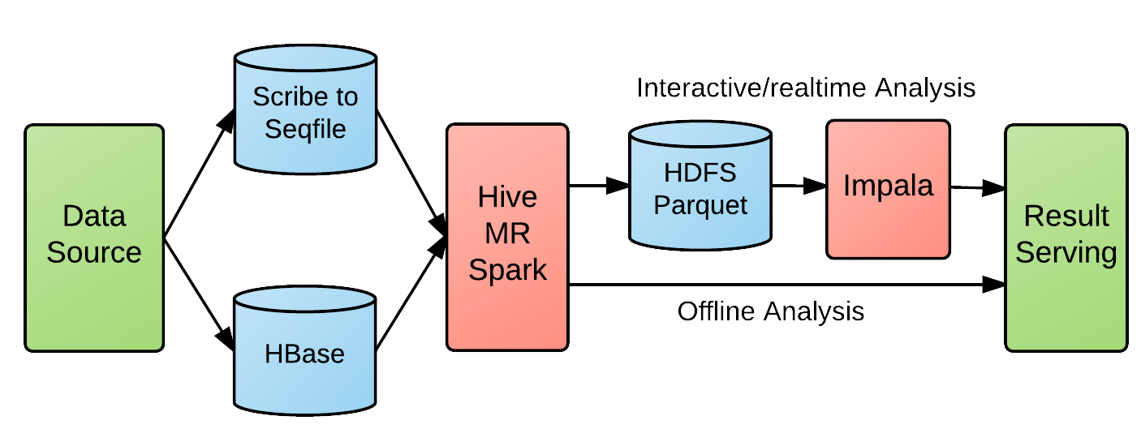
Xiaomi Big Data Analytics Pipeline
Before Kudu
Long pipeline
high latency(1 hour ~ 1 day), data conversion pains
No ordering
Log arrival(storage) order not exactly logical order
e.g. read 2-3 days of log for data in 1 day

Slide 15
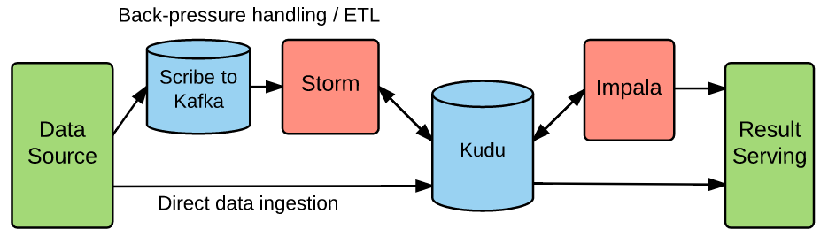
Xiaomi Big Data Analysis Pipeline
Simplified With Kudu
OLAP scan
Side table lookup
Result store
ETL Pipeline(0~10s latency)
Apps that need to prevent backpressure or require ETL
Direct Pipeline(no latency)
Apps that don’t require ETL and no backpressure issues

Slide 16
How it works
Replication and fault tolerance

Slide 17
Tables and Tablets
Table is horizontally partitioned into tablets
Range or hash partitioning
PRIMARY KEY (host, metric, timestamp) DISTRIBUTE BY HASH(timestamp) INTO 100 BUCKETS
bucketNumber = hashCode(row[‘timestamp’]) % 100
Each tablet has N replicas (3 or 5), with Raft consensus
Tablet servers host tablets on local disk drives

Slide 18
Metadata
Replicated master
Acts as a tablet directory
Acts as a catalog (which tables exist, etc)
Acts as a load balancer (tracks TS liveness, re-replicates under-replicated tablets)
Caches all metadata in RAM for high performance
Client configured with master addresses
Asks master for tablet locations as needed and caches them

Slide 19
Meta Cache
Hey Master! Where is the row for ‘tlipcon’ in table “T”?
Client
T1: …
T2: …
T3: …
It’s part of tablet 2, which is on servers {Z,Y,X}. BTW, here’s info on other tablets you might care about: T1, T2, T3, …
UPDATE tlipcon SET col=foo

Slide 20
Fault tolerance
Operations replicated using Raft consensus
Strict quorum algorithm. See Raft paper for details
Transient failures:
Follower: Leader can still achieve majority
Leader: automatic leader election (~5 seconds)
Restart dead TS within 5 min and it will rejoin transparently
Permanent failures
After 5 minutes, automatically creates a new follower replica and copies data
N replicas handle (N-1)/2 failures

Slide 21
How it works
Columnar storage

Slide 22
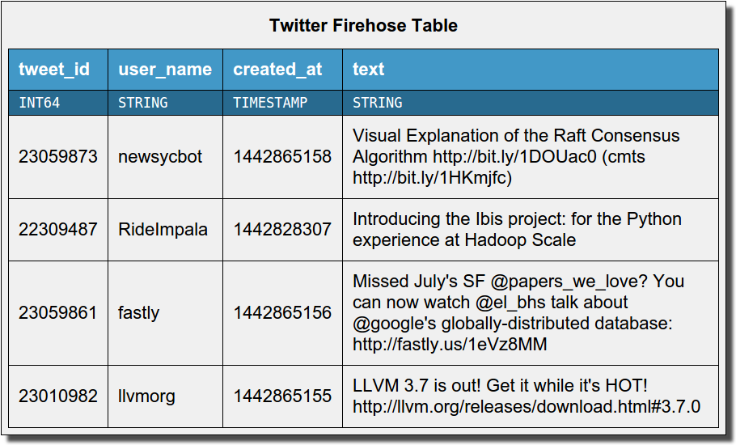
Columnar storage
Tweet_id
User_name
{25059873, 22309487, 23059861, 23010982}
{newsycbot, RideImpala, fastly, llvmorg}
Created_at
text
{1442865158, 1442828307, 1442865156, 1442865155}
{Visual exp…, Introducing .., Missing July…, LLVM 3.7….}

Slide 23
Columnar storage
Only read 1 column
Tweet_id
User_name
Created_at
text
{25059873, 22309487, 23059861, 23010982}
{newsycbot, RideImpala, fastly, llvmorg}
{1442865158, 1442828307, 1442865156, 1442865155}
{Visual exp…, Introducing .., Missing July…, LLVM 3.7….}
1GB
2GB
1GB
200GB
SELECT COUNT(*) FROM tweets WHERE user_name = ‘newsycbot’;

Slide 24
Columnar compression
Created_at | Diff(created_at)
1442865158 | n/a
1442828307 | -36851
1442865156 | 36849
1442865155 | -1
64 bits each | 17 bits each
Many columns can compress to a few bits per row!
Especially:
Timestamps
Time series values
Low-cardinality strings
Massive space savings and throughput increase!
Created_at
{1442865158, 1442828307, 1442865156, 1442865155}

Slide 25
Handling inserts and updates
Inserts go to an in-memory row store (MemRowSet)
Durable due to write-ahead logging
Later flush to columnar format on disk
Updates go to in-memory “delta store”
Later flush to “delta files” on disk
Eventually “compact” into the previously-written columnar data files
Details elided here due to time constraints
available in other slide decks online, or read the Kudu whitepaper to learn more!

Slide 26
Integrations

Slide 27
Spark DataSource integration (WIP)
sqlContext.load("org.kududb.spark", Map("kudu.table" -> “foo”, "kudu.master" -> “master.example.com”)) .registerTempTable(“mytable”)
df = sqlContext.sql(
“select col_a, col_b from mytable “ +
“where col_c = 123”)
https://github.com/tmalaska/SparkOnKudu

Slide 28
Impala integration
CREATE TABLE … DISTRIBUTE BY HASH(col1) INTO 16 BUCKETS AS SELECT … FROM …
INSERT/UPDATE/DELETE
Optimizations like predicate pushdown, scan parallelism, more on the way
Not an Impala user? Apache Drill integration in the works by Dremio

Slide 29
MapReduce integration
Most Kudu integration/correctness testing via MapReduce
Multi-framework cluster (MR + HDFS + Kudu on the same disks)
KuduTableInputFormat / KuduTableOutputFormat
Support for pushing predicates, column projections, etc

Slide 30
Performance

Slide 31
TPC-H (Analytics benchmark)
75 server cluster
12 (spinning) disk each, enough RAM to fit dataset
TPC-H Scale Factor 100 (100GB)
Example query:
SELECT n_name, sum(l_extendedprice * (1 - l_discount)) as revenue FROM customer, orders, lineitem, supplier, nation, region WHERE c_custkey = o_custkey AND l_orderkey = o_orderkey AND l_suppkey = s_suppkey AND c_nationkey = s_nationkey AND s_nationkey = n_nationkey AND n_regionkey = r_regionkey AND r_name = 'ASIA' AND o_orderdate >= date '1994-01-01' AND o_orderdate < '1995-01-01’ GROUP BY n_name ORDER BY revenue desc;

Slide 32
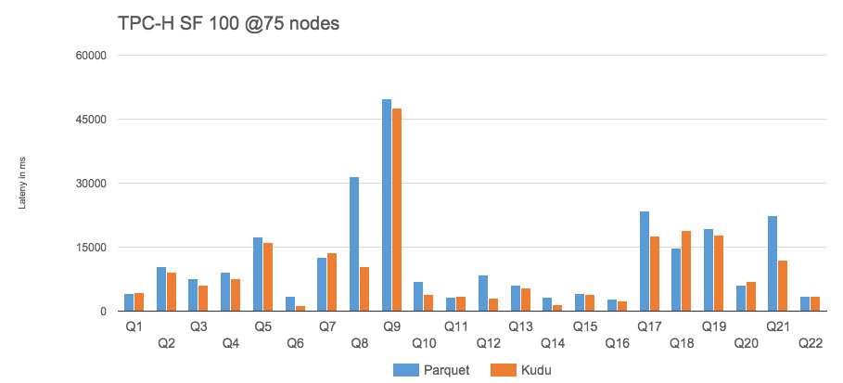
- Kudu outperforms Parquet by 31% (geometric mean) for RAM-resident data

Slide 33
Versus other NoSQL storage
Phoenix: SQL layer on HBase
10 node cluster (9 worker, 1 master)
TPC-H LINEITEM table only (6B rows)

Slide 34
Xiaomi benchmark
6 real queries from application trace analysis application
Q1: SELECT COUNT(*)
Q2: SELECT hour, COUNT(*) WHERE module = ‘foo’ GROUP BY HOUR
Q3: SELECT hour, COUNT(DISTINCT uid) WHERE module = ‘foo’ AND app=‘bar’ GROUP BY HOUR
Q4: analytics on RPC success rate over all data for one app
Q5: same as Q4, but filter by time range
Q6: SELECT * WHERE app = … AND uid = … ORDER BY ts LIMIT 30 OFFSET 30

Slide 35
Xiaomi: Benchmark Results
Query latency:
* HDFS parquet file replication = 3 , kudu table replication = 3
* Each query run 5 times then take average

Slide 36
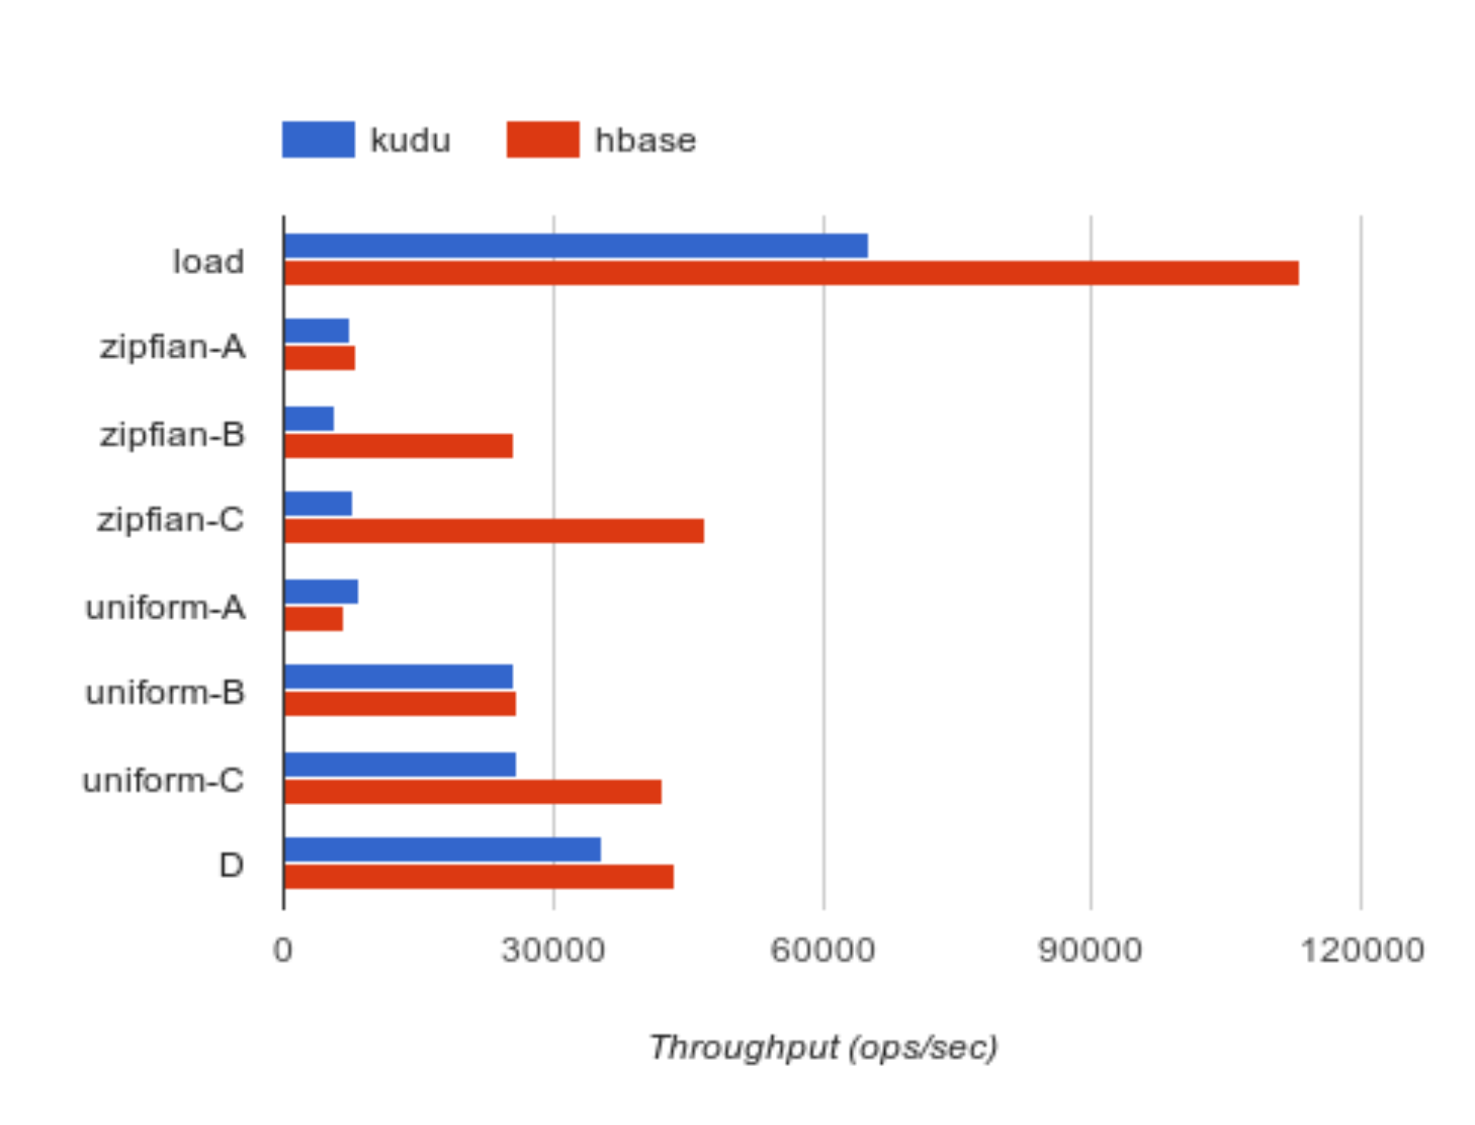
What about NoSQL-style random access? (YCSB)
YCSB 0.5.0-snapshot
10 node cluster (9 worker, 1 master)
100M row data set
10M operations each workload

Slide 37
Getting started

Slide 38
Project status
Open source beta released in September
First update version 0.6.0 released end of November
Usable for many applications
Have not experienced data loss, reasonably stable (almost no crashes reported)
Still requires some expert assistance, and you’ll probably find some bugs
Joining the Apache Software Foundation Incubator
Currently setting up infrastructure

Slide 39





Kudu Community
Your company here!

Slide 40
Getting started as a user
http://getkudu.io
kudu-user@googlegroups.com
http://getkudu-slack.herokuapp.com/
Quickstart VM
Easiest way to get started
Impala and Kudu in an easy-to-install VM
CSD and Parcels
For installation on a Cloudera Manager-managed cluster

Slide 41
Getting started as a developer
http://github.com/cloudera/kudu
All commits go here first
Public gerrit: http://gerrit.cloudera.org
All code reviews happening here
Public JIRA: http://issues.cloudera.org
Includes bugs going back to 2013. Come see our dirty laundry!
kudu-dev@googlegroups.com
Apache 2.0 license open source
Contributions are welcome and encouraged!

Slide 42
http://getkudu.io/ @getkudu

Slide 43

How it works
Write and read paths

Slide 44
Kudu storage – Inserts and Flushes
MemRowSet
INSERT
(“todd”, “$1000”,”engineer”)
flush
DiskRowSet 1
name
pay
role

Slide 45
Kudu storage – Inserts and Flushes
MemRowSet
INSERT
(“doug”, “$1B”, “Hadoop man”)
flush
DiskRowSet 2
name
pay
role
DiskRowSet 1
name
pay
role

Slide 46
Kudu storage - Updates
MemRowSet
Each DiskRowSet has its own DeltaMemStore to accumulate updates
DiskRowSet 2
Delta MS
name
pay
role
base data
DiskRowSet 1
Delta MS
name
pay
role
base data

Slide 47
Kudu storage - Updates
MemRowSet
UPDATE set pay=“$1M” WHERE name=“todd”
Is the row in DiskRowSet 2?
(check bloom filters)
DiskRowSet 2
Bloom says: no!
Delta MS
name
pay
role
base data
Is the row in DiskRowSet 1?
(check bloom filters)
DiskRowSet 1
Bloom says: maybe!
Delta MS
name
pay
role
150: pay=$1M @ time T
Search key column to find offset: rowid = 150

Slide 48
Kudu storage – Read path
MemRowSet
DiskRowSet 2
Delta MS
Read rows in DiskRowSet 2
name
pay
role
base data
Updates are applied based on ordinal offset within DRS: array indexing = fast
DiskRowSet 1
Delta MS
Then, read rows in DiskRowSet 1
name
pay
role
150: pay=$1M @ time T
base data

Slide 49
Kudu storage – Delta flushes
MemRowSet
A REDO delta indicates how to transform between the ‘base data’ (columnar) and a later version
DiskRowSet 2
Delta MS
name
pay
role
base data
DiskRowSet 1
Delta MS
REDO DeltaFile
Flush
name
pay
role
150: pay=$1M @ time T
base data

Slide 50
Kudu storage – Major delta compaction
Many deltas accumulate: lots of delta application work on reads
DiskRowSet(pre-compaction)
Delta MS
REDO DeltaFile
REDO DeltaFile
REDO DeltaFile
name
pay
role
Merge updates for columns with high update percentage
DiskRowSet(post-compaction)
Delta MS
UNDO deltas
Unmerged REDO deltas
name
pay
role
base data
If a column has few updates, doesn’t need to be re-written: those deltas maintained in new DeltaFile

Slide 51
Kudu storage – RowSet Compactions
DRS 1 (32MB)
[PK=alice], [PK=joe], [PK=linda], [PK=zach]
DRS 2 (32MB)
[PK=bob], [PK=jon], [PK=mary] [PK=zeke]
DRS 3 (32MB)
[PK=carl], [PK=julie], [PK=omar] [PK=zoe]
Reorganize rows to avoid rowsets with overlapping key ranges
DRS 4 (32MB)
DRS 5 (32MB)
DRS 6 (32MB)
[alice, bob, carl, joe]
[jon, julie, linda, mary]
[omar, zach, zeke, zoe]

Slide 52
Raft consensus
2b. Leader writes local WAL
Client
6. Leader->Client: Success!
TS A
WAL
Tablet 1
(LEADER)
1a. Client->Leader: Write() RPC
5. Leader has achieved majority
2a. Leader->Followers: UpdateConsensus() RPC
4. Follower->Leader: success
TS B
TS C
WAL
WAL
Tablet 1
(FOLLOWER)
Tablet 1
(FOLLOWER)
3. Follower: write WAL
3. Follower: write WAL

